Slide 1
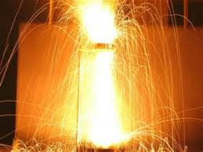
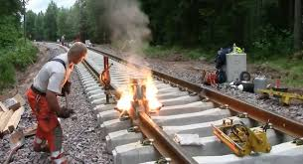
Energy: | Kinetic (Motion) Energy | Thermal (Heat) Energy
Particles | Molecules, Atoms | Electrons
Aluminum Foil
Symbol: Al(s) It is very Reactive Melting Point: 660°C Boiling Point: 2519°C (That’s HOT!)
Rust
Molecule: Fe₂O₃ (aka Iron (III) Oxide) Made of 2 kinds of Elements: Iron & Oxygen
Iron Symbol: Fe Iron is less reactive then Aluminum
Oxygen Symbol: O
Chemical Reaction | Fe₂O₃(s) + 2Al(s) → Al₂O₃(s) + 2Fe(s) + heat

Slide 2
Make Observations, Ask Questions Do Research
Observations
2 metal spheres
same size
1 Rust Fe₂O₃(s) also known as Iron (III) Oxide
1 covered in Aluminum foil
Questions
What is special about Aluminum foil or Rust? What is a chemical reaction? What does the periodic table tell me? Why is the melting point of Aluminum “hot?”
What happens when you strike an Aluminum sphere with a Rusty (Iron) sphere?
Research: INFO Bank

Slide 3
Make a Hypothesis
Aluminum will react with Iron and heat (spark, flame, light, heat) will be released.

Slide 4
Do Experiment (Safety Precautions)
Safety
Goggles,
ear protection,
UV glasses,
gloves,
fingers,
tight grip,
clothing/hair,
Space,
Behaviour
Steps
Strike spheres against each other

Slide 5
Collect Data (Make Observations)
Sound
Light
Spark
Heat
Aluminum foil worn away
Rust worn away,
Aluminum fused to sphere

Slide 6
Draw Conclusions
Thermite (Goldschmidt) Reaction

Slide 7
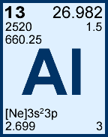
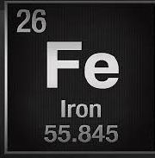
Energy: | Kinetic (Motion) Energy | Thermal (Heat) Energy
Particles | Molecules, Atoms | Electrons
Aluminum Foil
Symbol: Al(s) It is very Reactive Melting Point: 660°C Boiling Point: 2519°C (That’s HOT!)
Rust
Molecule: Fe₂O₃ (aka Iron (III) Oxide) Made of 2 kinds of Elements: Iron & Oxygen
Iron Symbol: Fe Iron is less reactive then Aluminum
Oxygen Symbol: O
Chemical Reaction | Fe₂O₃(s) + 2Al(s) → Al₂O₃(s) + 2Fe(s) + heat

Slide 8
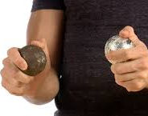
Energy: | Kinetic (Motion) Energy | Thermal (Heat) Energy
Particles | Molecules, Atoms | Electrons
FRICTION = SPARK

Slide 9
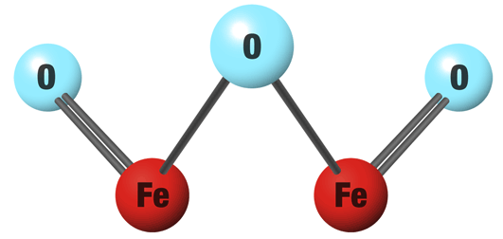
Fe₂O₃(s) + 2Al(s) → Al₂O₃(s) + 2Fe(s) + HEAT
Aluminum Foil
Symbol: Al(s) It is very Reactive Melting Point: 660°C Boiling Point: 2519°C (That’s HOT!)
Rust
Molecule: Fe₂O₃ (aka Iron (III) Oxide) Made of 2 kinds of Elements: Iron & Oxygen
Iron Symbol: Fe Iron is less reactive then Aluminum
Oxygen Symbol: O

Slide 10
Fe₂O₃(s) + 2Al(s) → Al₂O₃(s) + 2Fe(s) + HEAT

Slide 11
Real Life Applications
Thermite Reaction: Welding Railroad tracks
https://www.youtube.com/watch?v=-7JfNBmcjXo

