Slide 1
Circle – Circumference & Perimeter – Demonstration
This resource provides animated demonstrations of the mathematical method.
Check animations and delete slides not needed for your class.

Slide 2
Circumference
Circumference = 3….. × Diameter
What is the relationship
between a circle’s
circumference and its diameter?
Circumference = 3.1415926535… × Diameter
Diameter
Circumference = $π$ × Diameter
$π$ (Pi) is the relationship between
a circle’s diameter and its circumference.
Circumference
Diameter 1
Diameter 2
Diameter 3
3.14
Notes:
Preview the slide show to check the animations.

Slide 3
Circumference
Diameter
Circumference = $π$ × Diameter
$π$ (Pi) is the relationship between
a circle’s diameter and its circumference.
Circumference
Diameter 1
Diameter 2
Diameter 3
3.14

Slide 4
DEMO
Circumference of a Circle
Find the circumference of this circle.
Circumference = $π$ x Diameter
5 cm
4 cm
$$C=π×5$$
$$=15.71 cm$$
(2dp)

Slide 5
DEMO
Circumference of a Circle
Find the circumference of this circle.
Circumference = $π$ x Diameter
7 cm
6.5 cm
$$C=π×7$$
$$=21.99 cm$$
(2dp)

Slide 6
DEMO
Circumference of a Circle
Find the circumference of this circle.
Circumference = $π$ x Diameter
3 cm
5.5 cm
$$C=π×(2×3)$$
$$=18.85 cm$$
(2dp)

Slide 7
DEMO
Circumference of a Circle
Find the perimeter of this shape.
Circumference = $π$ x Diameter
10 cm
$$P=A+B$$
$$A=(π×10)÷2$$
$$B=10$$
$$P=25.71 cm$$
(2dp)

Slide 8
DEMO
Circumference of a Circle
YOUR TURN
Find the circumference of this circle.
Find the circumference of this circle.
Circumference = $π$ x Diameter
6 cm
5 cm
8 cm
4 cm
$$C=π×5$$
$$C=π×8$$
$$=15.71 cm$$
(2dp)
$$=25.13 cm$$
(2dp)

Slide 9
DEMO
Circumference of a Circle
YOUR TURN
Find the circumference of this circle.
Find the circumference of this circle.
Circumference = $π$ x Diameter
11 cm
5 cm
4 cm
7 cm
$$C=π×5$$
$$C=π×14$$
$$=15.71 cm$$
(2dp)
$$=43.98 cm$$

Slide 10
DEMO
Circumference of a Circle
YOUR TURN
Find the circumference of this circle.
Find the perimeter of this shape.
Circumference = $π$ x Diameter
5 cm
4 cm
8 cm
$$P=A+B$$
$$C=π×5$$
$$A=(π×8)÷2$$
$$=15.71 cm$$
(2dp)
$$B=8$$
$$P=20.57 cm$$
(2dp)

Slide 11
Circumference = $π$ x Diameter
Find the perimeter of these shapes to 1dp.
20.6 m
3 cm
12 cm
8 m
37.7 cm
18.8 cm
5cm
2cm
Answers
20.3 cm
9 cm
7 cm
29.1 cm
32.1 cm
50.0 cm
3 cm
(49.991)
10 cm

Slide 12
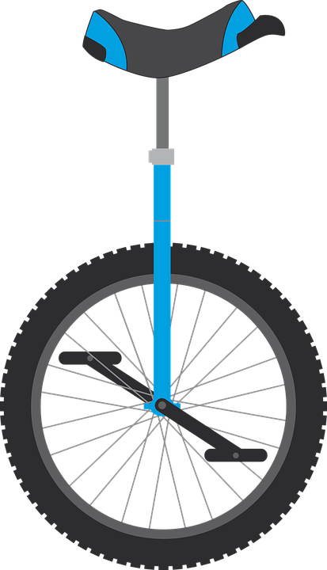
27488.9cm = 274.9m
35cm
A car wheel has a radius of 35cm.
If it rolls 125 times,
how far does it travel?
60cm
A bicycle wheel has a 60cm diameter.
How many times would it rotate if
the bicycle travelled 100 meters?
Answers
53.05 times = 53 times
A unicycle’s wheel has a radius of 28cm.
How many complete revolutions would it take a rider to travel 1.3Km?
738.9 times = 739 complete revs
The unicycle’s pedal is 15cm long.
How far does the rider need to move
both feet to travel 1.3Km?
739 × 30$π$ × 2
= 1.392Km

Slide 13
A rubber band is stretched around 16 tubes.
Each tube has a diameter of 6cm
How far must the rubber band stretch?
A running track has two 1 meter wide tracks.
On the inside track, the runner starts at A.
How much further forward should a runner on the
outside track start so they have to run the
same distance to the finish?
(2dp)
(2dp)
50m
70m
A
A washing machine’s drum has a radius of 35cm.
At full speed it spins at 1100 RPM
(revolutions per minute).
If a spider was stuck on the inside,
how far would it travel in 90 seconds?
John bicycle wheel has a radius of 65cm.
His son’s wheel has a diameter of 80cm.
After travelling 100 meters, how many more
whole revolutions has
John’s son’s wheel completed?
(2dp)

Slide 14
A rubber band is stretched around 16 tubes.
Each tube has a diameter of 6cm
How far must the rubber band stretch?
A running track has two 1 meter wide tracks.
On the inside track, the runner starts at A.
How much further forward should a runner on the
outside track start so they have to run the
same distance to the finish?
(2dp)
(2dp)
6.28 m
50m
70m
90.85 cm
A
A washing machine’s drum has a radius of 35cm.
At full speed it spins at 1100 RPM
(revolutions per minute).
If a spider was stuck on the inside,
how far would it travel in 90 seconds?
John bicycle wheel has a radius of 65cm.
His son’s wheel has a diameter of 80cm.
After travelling 100 meters, how many more
whole revolutions has
John’s son’s wheel completed?
(2dp)
15 more revolutions
(24.5 vs 39.8)
3.63 km
Answers

Slide 16
Questions?
Comments?
Suggestions?
…or have you found a mistake!?
Any feedback would be appreciated ☺.
Please feel free to email:
tom@goteachmaths.co.uk

